Slide 1

Wall Street Crash of 1929
By theodore junior serbanescu

Slide 2

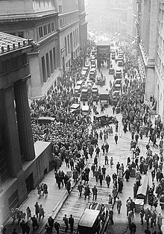

Wall Street Crash of 1929
The Wall Street Crash of 1929, also known as the Great Crash, was a major stock market crash that occurred in 1929. It started in September and ended late in October, when share prices on the New York Stock Exchange collapsed.
It was the most devastating stock market crash in the history of the United States, when taking into consideration the full extent and duration of its after-effects.The crash, which followed the London Stock Exchange's crash of September, signaled the beginning of the Great Depression.

Slide 3

Background
The Roaring Twenties, the decade that followed World War I that led to the crash, was a time of wealth and excess. Building on post-war optimism, rural Americans migrated to the cities in vast numbers throughout the decade with the hopes of finding a more prosperous life in the ever-growing expansion of America's industrial sector. While American cities prospered, the overproduction of agricultural produce created widespread financial despair among American farmers throughout the decade. This would later be blamed as one of the key factors that led to the 1929 stock market crash.
Despite the dangers of speculation, it was widely believed that the stock market would continue to rise forever. On March 25, 1929, after the Federal Reserve warned of excessive speculation, a small crash occurred as investors started to sell stocks at a rapid pace, exposing the market's shaky foundation.[5Two days later, banker Charles E. Mitchell announced that his company, the National City Bank, would provide $25 million in credit to stop the market's slide. Mitchell's move brought a temporary halt to the financial crisis, and call money declined from 20 to 8 percent.

Slide 4
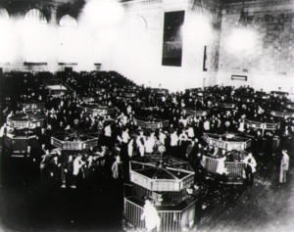
Crash
Selling intensified in mid-October. The market lost 11 percent of its value at the opening bell on very heavy trading. The huge volume meant that the report of prices on the ticker tape in brokerage offices around the nation was hours late and so investors had no idea what most stocks were actually trading for. Several leading Wall Street bankers met to find a solution to the panic and chaos on the trading floor.^{[8]} The meeting included Thomas W. Lamont, acting head of Morgan Bank; Albert Wiggin, head of the Chase National Bank; and Charles E. Mitchell, president of the National City Bank of New York. They chose Richard Whitney, vice president of the Exchange, to act on their behalf.
With the bankers' financial resources behind him, Whitney placed a bid to purchase a large block of shares in U.S. Steel at a price well above the current market. As traders watched, Whitney then placed similar bids on other "blue chip" stocks. The tactic was similar to one that had ended the Panic of 1907. It succeeded in halting the slide. The Dow Jones Industrial Average recovered, closing with it down only 6.38 points for the day.

Slide 5






The end!
By learning about our past we can prepare better for the future!

